Slide 1

CS144 Course Intro (Fall 2025)
Keith Winstein
Notes:
<number>

Slide 2

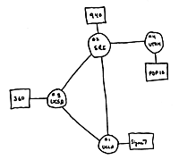
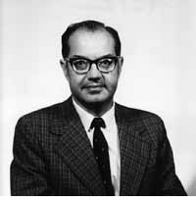
Four nodes connected (UCLA, SRI, UCSB, Utah)
Wireless Communications: 1964
“A network to survive nuclear attack.”
US Government starts “ARPANET” project
1st network connects two computers
Paul Baran
1964
1965
1966
1968
1969
Notes:
<number>

Slide 3
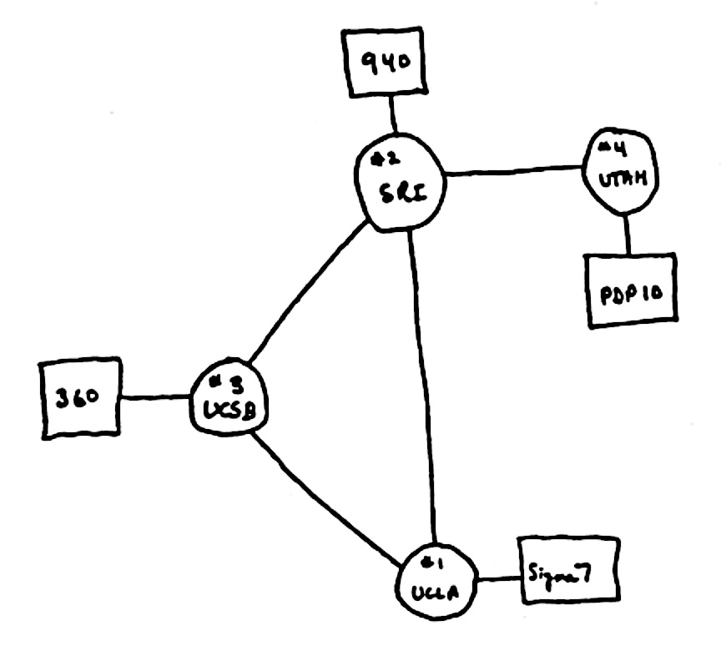

The Internet in 1969
“router”
“end host”
Also in 1969
“link”
Notes:
<number>

Slide 4
What did they use it for?
“router”
“end host”
“link”
Sending files between scientists: “Here is a big file of astronomy data!”
Email: “Where shall we have lunch today?”
Remote login to another computer.
Notes:
<number>

Slide 5
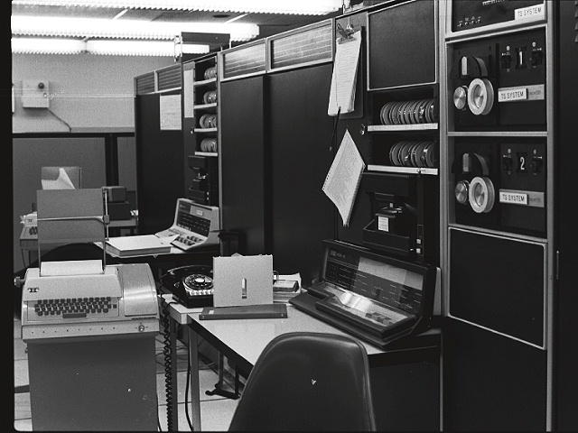
1971
First email typed here
“QWERTYUIOP”
…and printed here

Slide 6
“router”
1993
1,000,000 “end hosts”
“end host”
“link”
1988
10,000 “end hosts”
1969
4 “end hosts”
Network Systems: 1984
Notes:
<number>

Slide 7
Then in 1993 something even BIGGER happened!!!

Slide 8
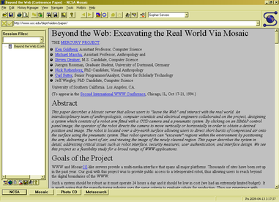

1993: The first web browser (Mosaic)
Marc Andreessen

Slide 9
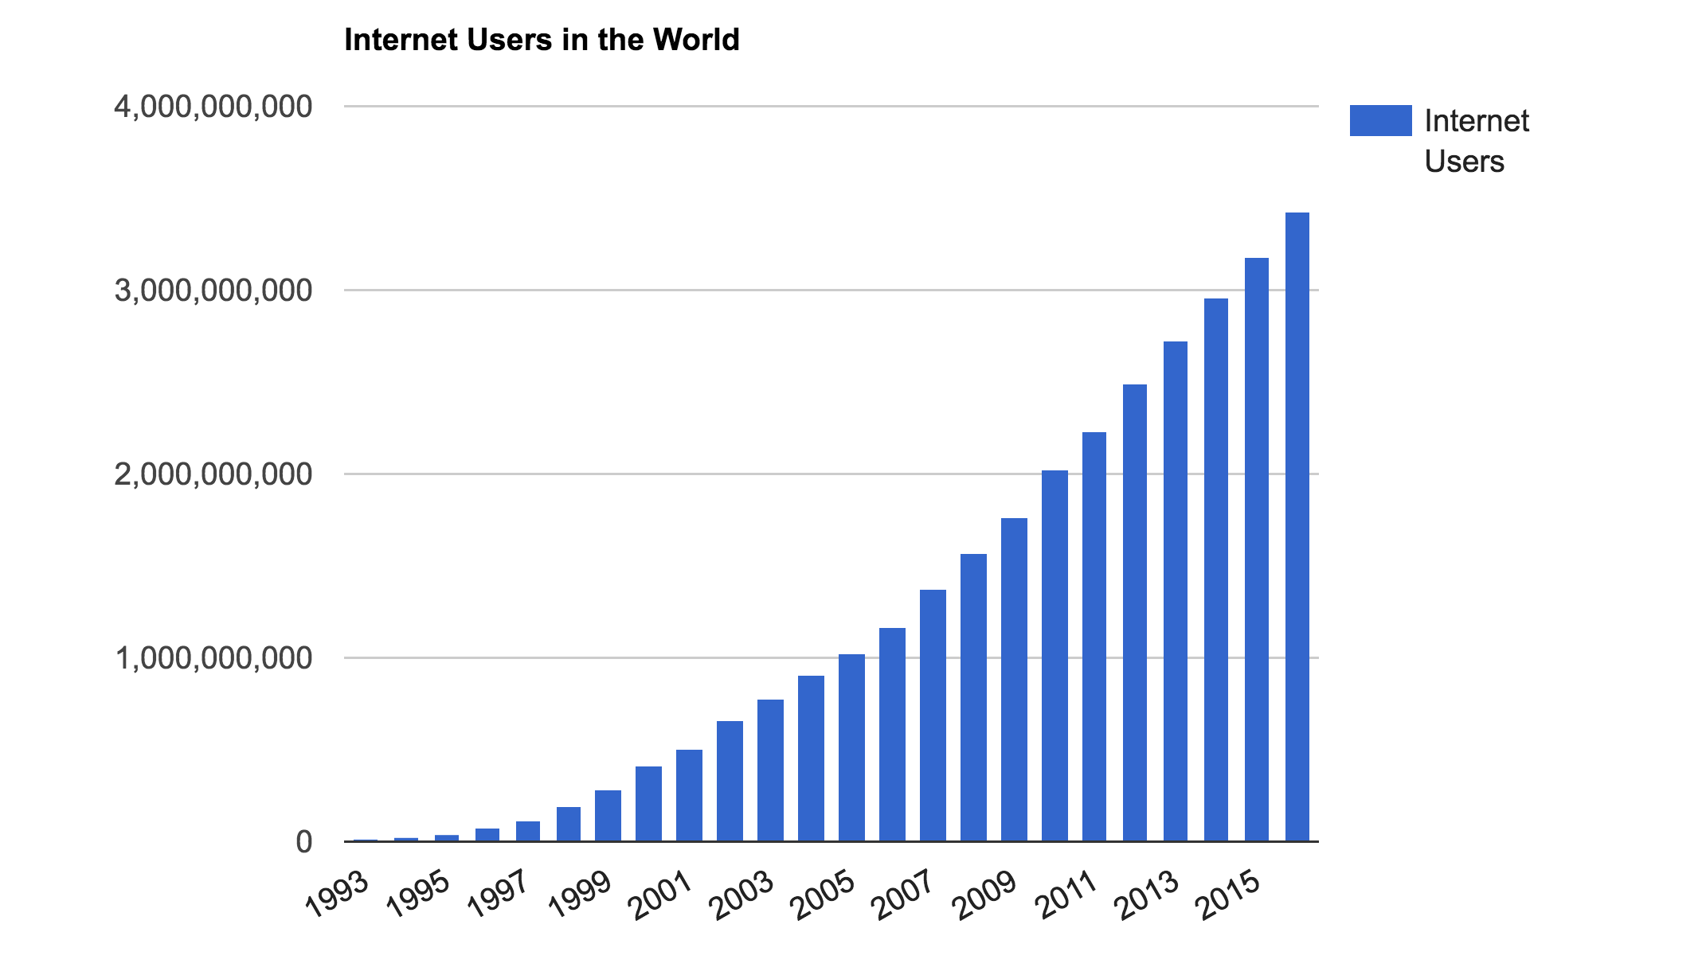
The number of Internet users in the world
3.6B people
~ 40% of world
Source: http://www.internetlivestats.com/
Notes:
Internet user = someone who has access to the Internet from home (by any device)
7.4B in the world, so still less than 50% of people.

Slide 10

Notes:
<number>

Slide 11
How does it all work?
Why was it designed this way?

Slide 12
CS144
Isn’t it really difficult….?

Slide 13
Goals
To learn how the Internet works.
To learn why the Internet was designed this way.
To learn how to use the Internet.
To build some significant pieces of the Internet.
To learn the underlying principles and technologies of networking.

Slide 14
Class overview
CS144 is a fast-paced lab class.
Each week has THREE lectures and ONE lab session.
1:30-2:20 p.m. (Please no distracting laptop usage!)
The is divided into week-long units, devoted to a particular topic. e.g. the 1st week is about Basic Principles, then (2) Transport, (3) Packet Switching, (4) Congestion Control, (5) the practical Internet, (6) Applications, (7) Routing, ...
There is ONE BIG LAB ASSIGNMENT (“you build most of the Internet”) with 8 “checkpoints,” #0 through #7.

Slide 15
Laptops
We discourage laptop use in class, especially use that will distract others behind you.
Except for specific in-class exercises (we will ask you to bring your laptop).

Slide 16
How we calculate your grade
Participation 3%
Helping others on Ed or in the lab sessions
Credit in somebody else’s lab writeup
Quizzes 12%
Best 6 out of 8: 2% each
The lab 45%
Correctness: 27%
Checkpoints 0-7 subjective grades, best 6 out of 8: 18% (3% each)
Exams 40%
Midterm (Oct. 29): 20% (lab slot)
Final (Dec. 10): 20% (duration TBA)
Q: “What does it take to earn an A?”

Slide 17
Exam Policy
Exams are closed-book, closed-note, closed-laptop etc.
But you may bring 1 double-sided piece of 8.5” x 11” paper of your own design to the Midterm, and 2 double-sided pieces of paper to the Final.
<number>

Slide 18
COVID
This quarter may suck present lousy circumstances. :-(
My job is to help you learn. I really want that to happen.
We’re going to have to react to curveballs and we will do our best.
If you have to quarantine, we will be there for you (online) to help you avoid falling behind.
<number>

Slide 19
Lab
Programming is in modern C++
CS111 and C++ comfort are prerequisites.
You want to go to the lab sessions + have started already
Deadline policy:
Lab checkpoints are due Sundays, 11:59 p.m. (except week 6)
If you turn checkpoint in on time, we will get you subjective feedback and grade by Friday 11:59 p.m.
Late/extension deadline is Wednesday, 7 p.m. (just before lab session). We can’t guarantee a grading timeline for these, but you can ask for feedback at lab session. Please do not ask for speedy grades for late submissions.
Functionality/correctness: no-penalty regrades until end of class.
If you do not make the “late” deadline, lab attendance is required.
<number>

Slide 20
Win Certificates!!!
Your name here
Certificate for BEST checkpoint submission
Certificate for BEST help (credited in lab writeups)
Certificate for BEST help (on Ed)
<number>

Slide 21
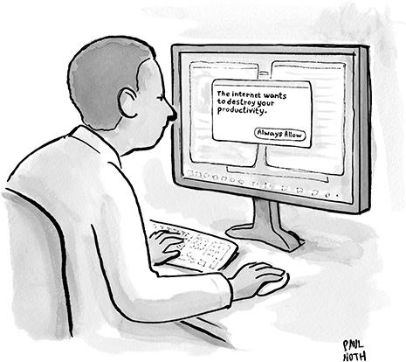
Workload
This is a 4-unit workload, which means a workload of about 12hrs/week
Our estimate based on previous years
Class time: 3hrs/week
Labs: Avg 6hrs/week
wide variance between checkpoints and between students
read the whole checkpoint BEFORE coding
Average overall ~12hrs/week

Slide 22
Contact
For anything non-private: Ed
If private: Private Ed posting
If it’s personal (e.g. a medical emergency):
email Keith keithw@cs.stanford.edu
(If it’s a mega-emergency, Keith’s cell phone number is on his Web page.)

Slide 23
The Honor Code
We take it seriously and we expect you to take it seriously too.
Last year was a bad year with several CS144 students cheating. None of them exactly set out to cheat: They had other priorities. They had a sick parternet. They asked friends for “help” and got tempted by their screens. Or they copied an assignment off the web, then tried to modify it.
We use tools to compare solutions against past ones.
Please, let’s have a zero-violation year. The Honor Code is an amazing commitment by the students to govern and deter cheating themselves because you don’t want the faculty to police you. Please show that student self-government and mutual deterrence works so we can keep faculty out of it.

Slide 24
The Honor Code
Permitted Collaboration: The following items are encouraged and allowed at all times for all students in this class:
Discussion of material covered during lecture, problem sessions, or in handouts
Discussion of the requirements of an assignment
Discussion of the use of tools or development environments
Discussion of general approaches to solving problems
Helping others at the lab session (without looking at code!)
Discussion of general techniques of coding or debugging
<number>

Slide 25
The Honor Code
Unpermitted Collaboration: All submissions must represent original, independent work. Some examples of activities that do not represent original work include:
Copying solutions from others or knowingly allowing others to copy your solution.
Use of solutions posted to websites.
Looking at another student’s code (unless handwritten, not CS144-specific, and credited).
Placing your source code in a public repository where others can copy it.
Debugging code for someone else.
Collaborating on or discussing the online graded quizzes before you have completed them.
Using output from a code-synthesis tool (e.g. an LLM) trained on past students’ solutions.
Honor code exercise: can you stump the teaching staff?
<number>

Slide 26
What to do next
Look around and get familiar with https://cs144.stanford.edu
Start setting up your VM for Checkpoint 0! It is due this Sunday.
See you Wednesday!
<number>
Notes:
<number>

Slide 27
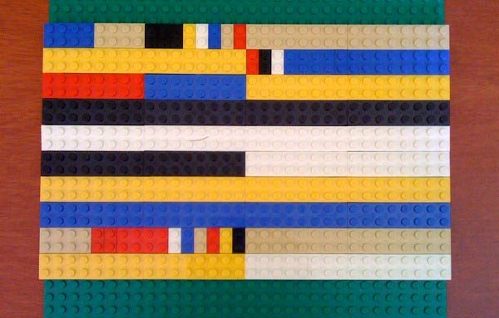
TCP/IP Header Formats in Lego

